Slide 1
Capstone Engagement
Assessment, Analysis, and Hardening of a Vulnerable System

Slide 2
Table of Contents
This document contains the following sections:
01
Network Topology
02
Red Team: Security Assessment
03
Blue Team: Log Analysis and Attack Characterization
Hardening: Proposed Alarms and Mitigation Strategies
04

Slide 3
Network Topology
3

Slide 4
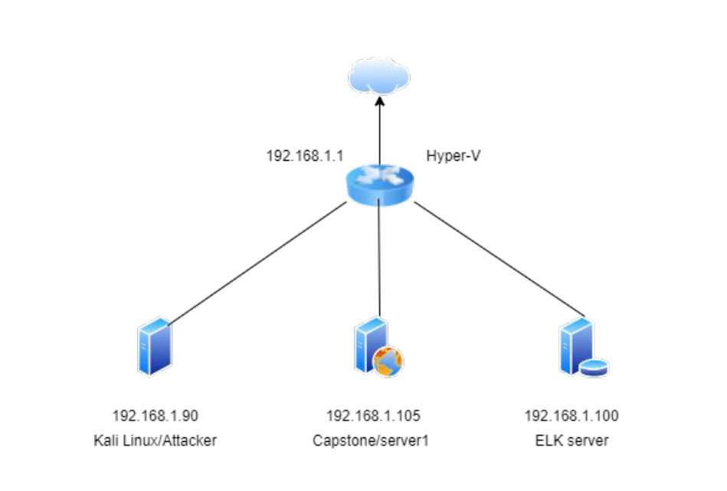
Network Topology
[Insert Here]
Use draw.io to create a diagram of the network.
Add your diagram to this slide and fill out the data in the sidebar.
Network
Address Range: 192.168.1.0/24
Netmask:255.255.255.0
Gateway:192.168.1.1
Machines
IPv4:192.168.1.1
OS:Microsoft
Hostname:Hyper-V
IPv4:192.168.1.90
OS:Kali Linux
Hostname: Kali
IPv4:192.168.1.100
OS:Linux
Hostname:ELK
IPv4:192.168.1.105
OS:Linux
Hostname:Server1/Capstone

Slide 5

Red Team
Security Assessment
5

Slide 6
Recon: Describing the Target
Nmap identified the following hosts on the network:
Hostname | IP Address | Role on Network
Hyper-V | 192.168.1.1 | Default Gateway
Kali | 192.168.1.90 | Attacker Machine
ELK | 192.168.1.100 | Logging Server/SEIM
Capstone/Server1 | 192.168.1.105 | Victim Machine

Slide 7
Vulnerability Assessment
The assessment uncovered the following critical vulnerabilities in the target:
Vulnerability | Description | Impact
1 Brute Force Vulnerability | Brute Force Vulnerability allows multiple failed authentications attempts from the same account | Brute Force Vulnerability allows attackers get credentials that access to password protected area on Capstone/server1
2 Exposing sensitive information | Sensitive information becomes accessible from internet. | Attackers can gain access to sensitive information.
3 LFI Vulnerability | LFI allows access to confidential files on a site. | An LFI vulnerability allows attackers to gain access to sensitive credentials
4 Remote Code Execution | Execute shell commands on the web-server from the remote device | The vulnerability allows an attacker to execute malicious script provides command and control over Capstone/server1

Slide 8
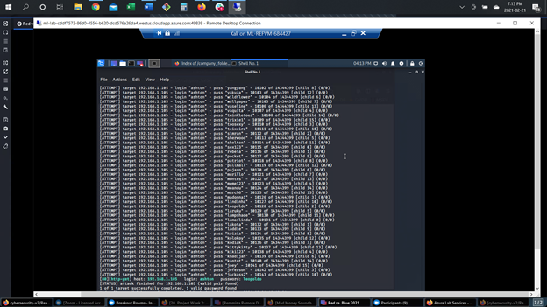
Exploitation: Brute Force Vulnerability
01
02
03
Tools & Processes
Using command line tool Hydra I ran the following command:
‘hydra -l ashton -P /usr/share/wordlist/rockyou.txt -s 80 -f -vV 192.168.1.105 http-get /company_folders/secret_folder’
Achievements
I was able to brute force the credentials for user ‘ashton’ and log in to the ‘secret_folder’ using password ‘leopoldo’

Slide 9
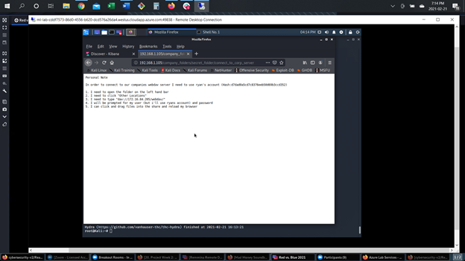
Exploitation: Sensitive Data Exposure
01
02
03
Tools & Processes
I used the web browser to navigate to the website and look for sensitive information.
Achievements
I found a path to the secret_folder and got information about company top management.

Slide 10
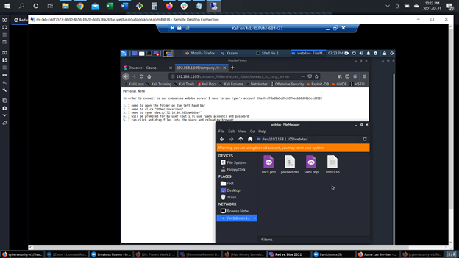
Exploitation: Local File Inclusion Vulnerability
01
02
03
Tools & Processes
Using command line tool Dirb I was able to find urls on the target website.
Achievements
Following urls were found:
http://192.168.1.105/webdav/
http://192.168.1.105/server-status
[INSERT: screenshot or command output illustrating the exploit.]

Slide 11
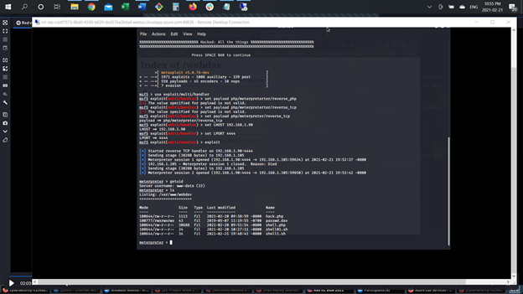
Exploitation: Remote Code Execution
01
02
03
Tools & Processes
To exploit this vulnerability I used Metasploit, in particular multi/handler.
Achievements
On this stage I successfully got possession of the victim’s machine Capstone 192.168.1.105 through port 4444. I was able to explore the Capstone’s files and find flag.txt file.
[INSERT: screenshot or command output illustrating the exploit.]

Slide 12

Blue Team
Log Analysis and Attack Characterization
12

Slide 13

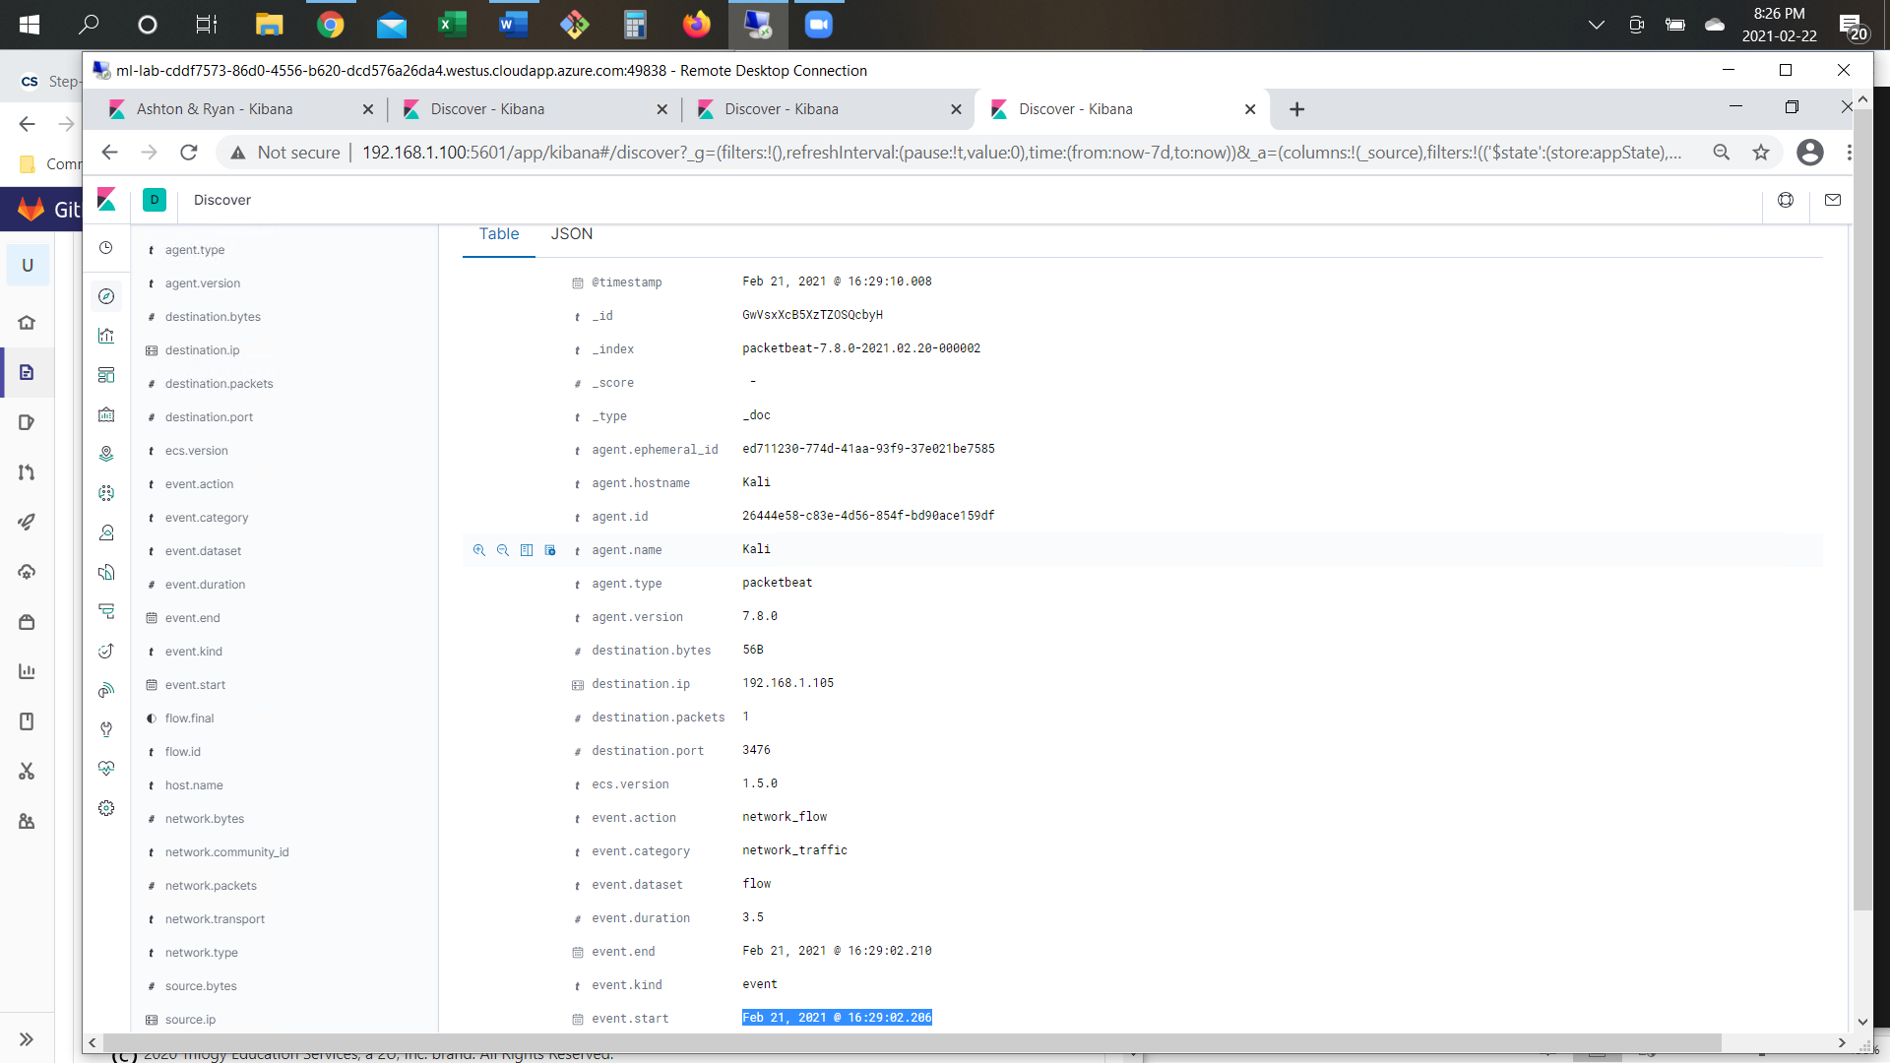
Analysis: Identifying the Port Scan
Answer the following questions in bullet points under the screenshot if space allows. Otherwise, add the answers to speaker notes.
The port scan took place on Feb 21, 2021 @ 16:29?
Over 20.000 packets were sent from IP 192.168.1.90.
Port scan determined based on large number of connections from the same IP
[Insert Here]
Include a screenshot of Kibana logs depicting the port scan.

Slide 14
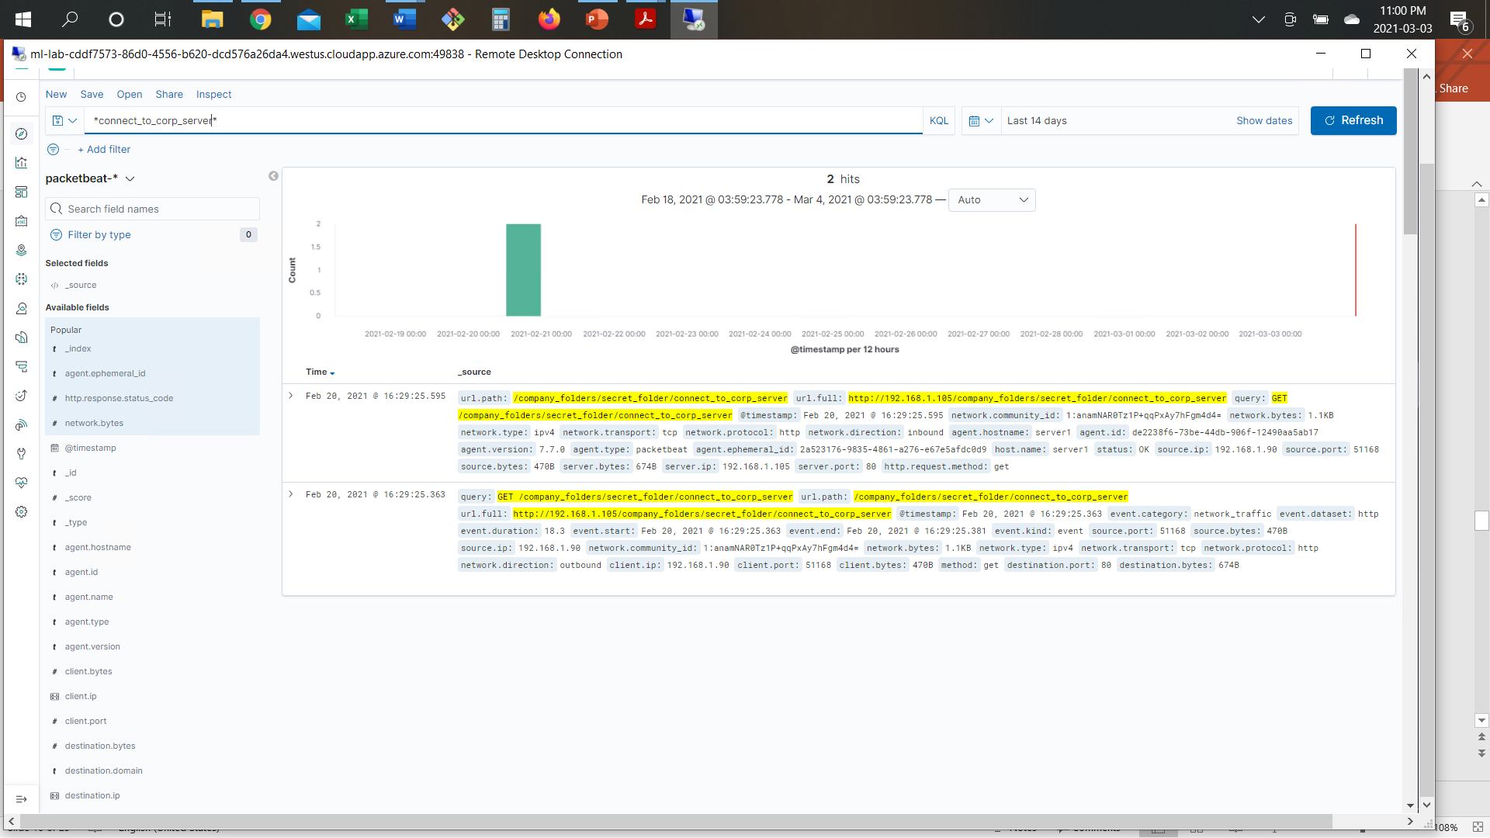
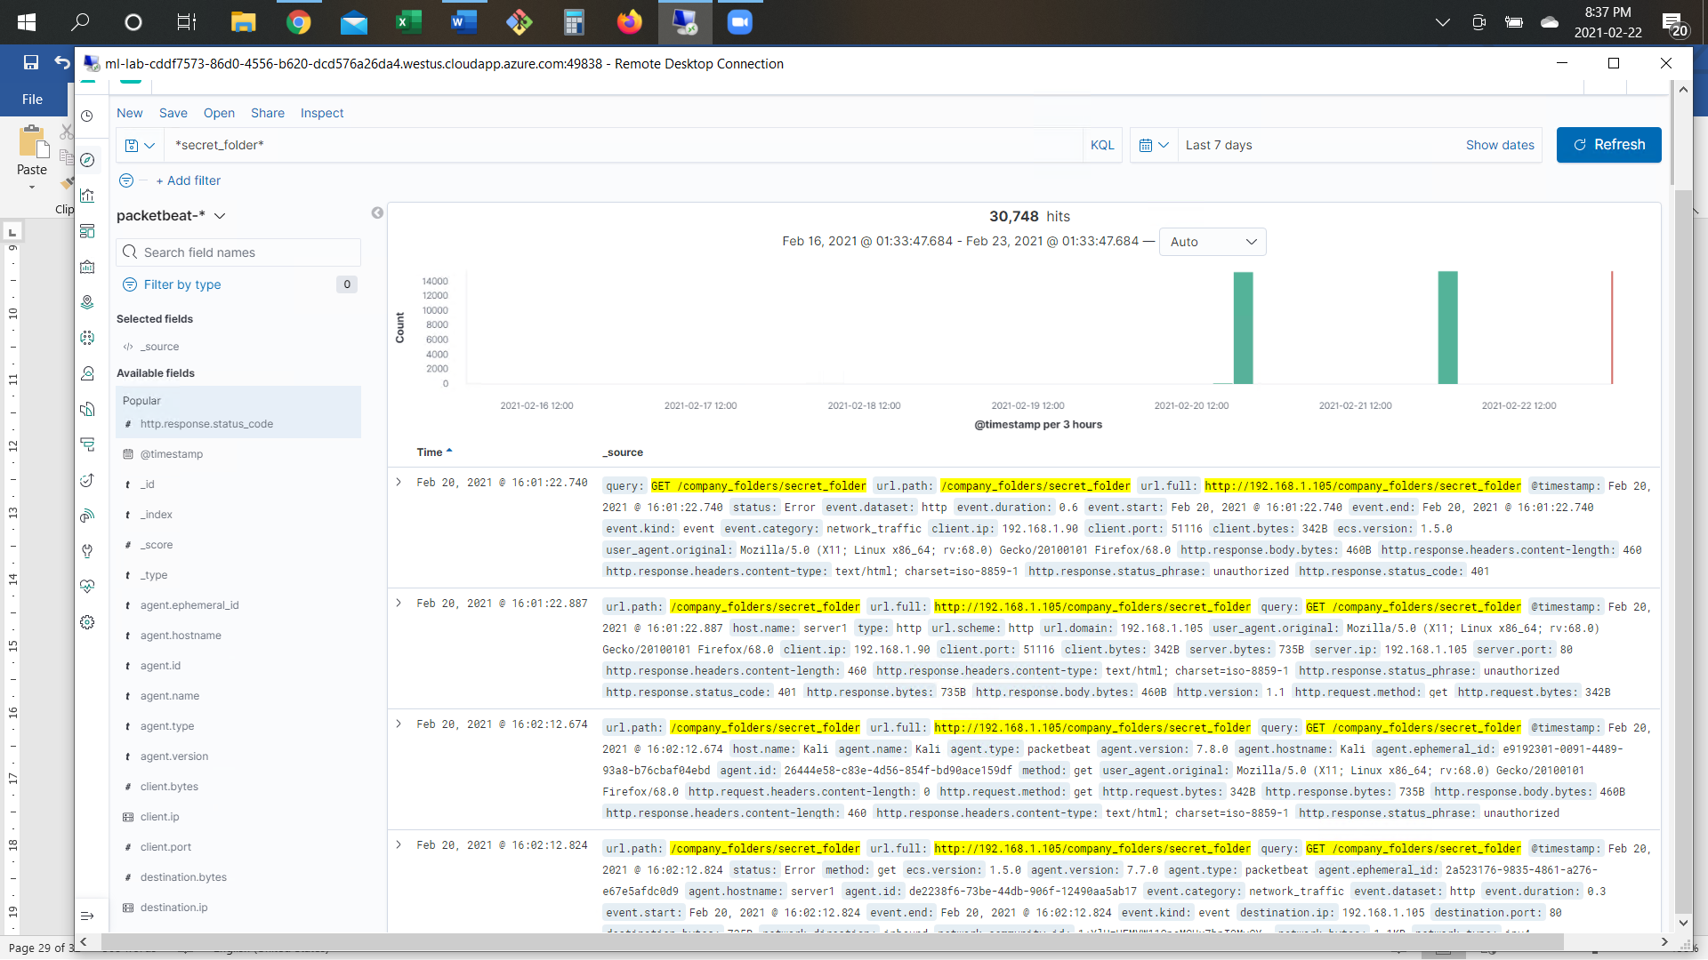
Analysis: Finding the Request for the Hidden Directory
Answer the following questions in bullet points under the screenshot if space allows. Otherwise, add the answers to speaker notes.
The request to access ‘connect_to_corp_server’ took place on February 21. Two requests were made.
GET /company_folders/secret_folder/connect_to_corp_server. The files contained info about CEO’s hashed password.
[Insert Here]
Include a screenshot of Kibana logs depicting the request for the hidden directory.

Slide 15
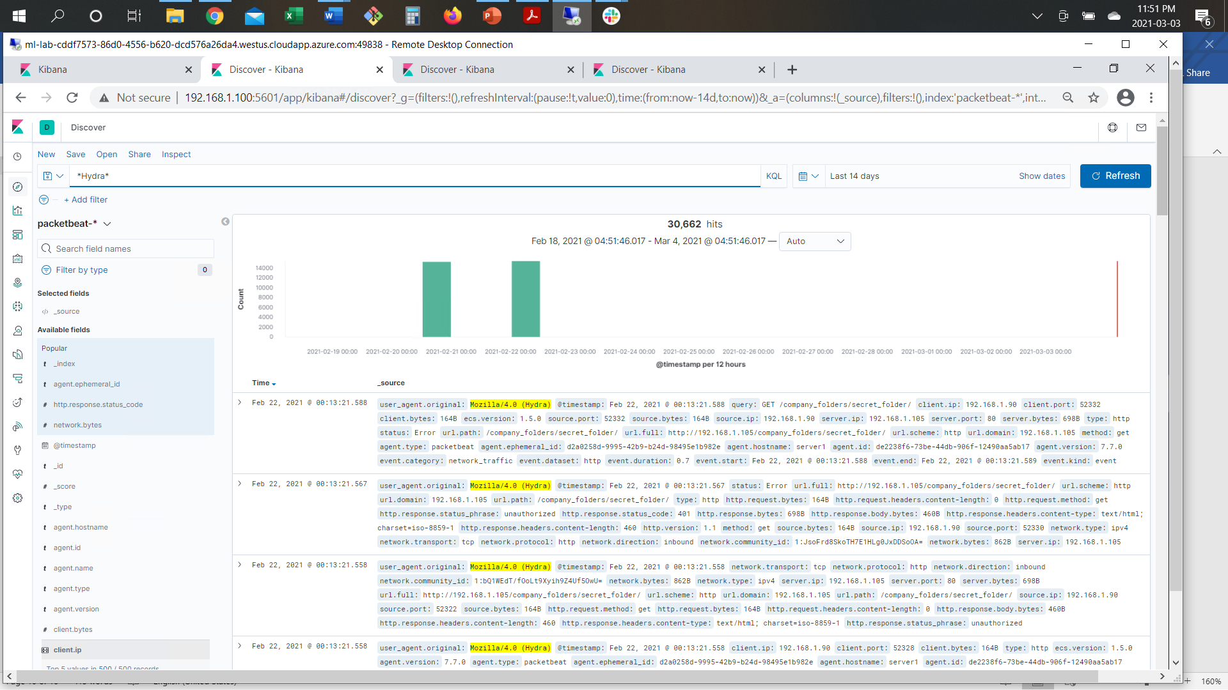
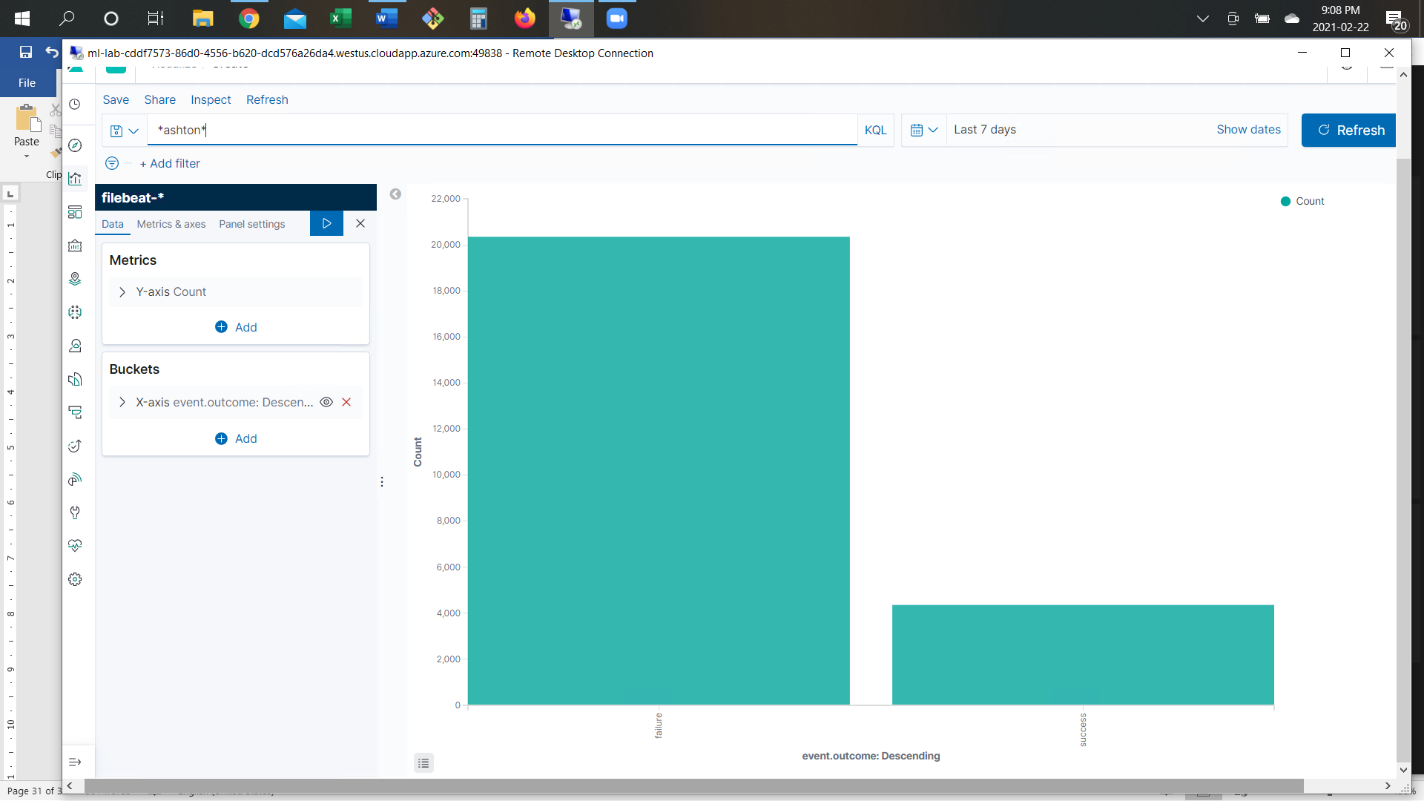
Analysis: Uncovering the Brute Force Attack
Answer the following questions in bullet points under the screenshot if space allows. Otherwise, add the answers to speaker notes.
Over 20.000 requests were made in the Brute Force Attack?
Total minus one requests had been made before the attacker discovered the password for ashton account?
[Insert Here]
Include a screenshot of Kibana logs depicting the brute force attack.

Slide 16
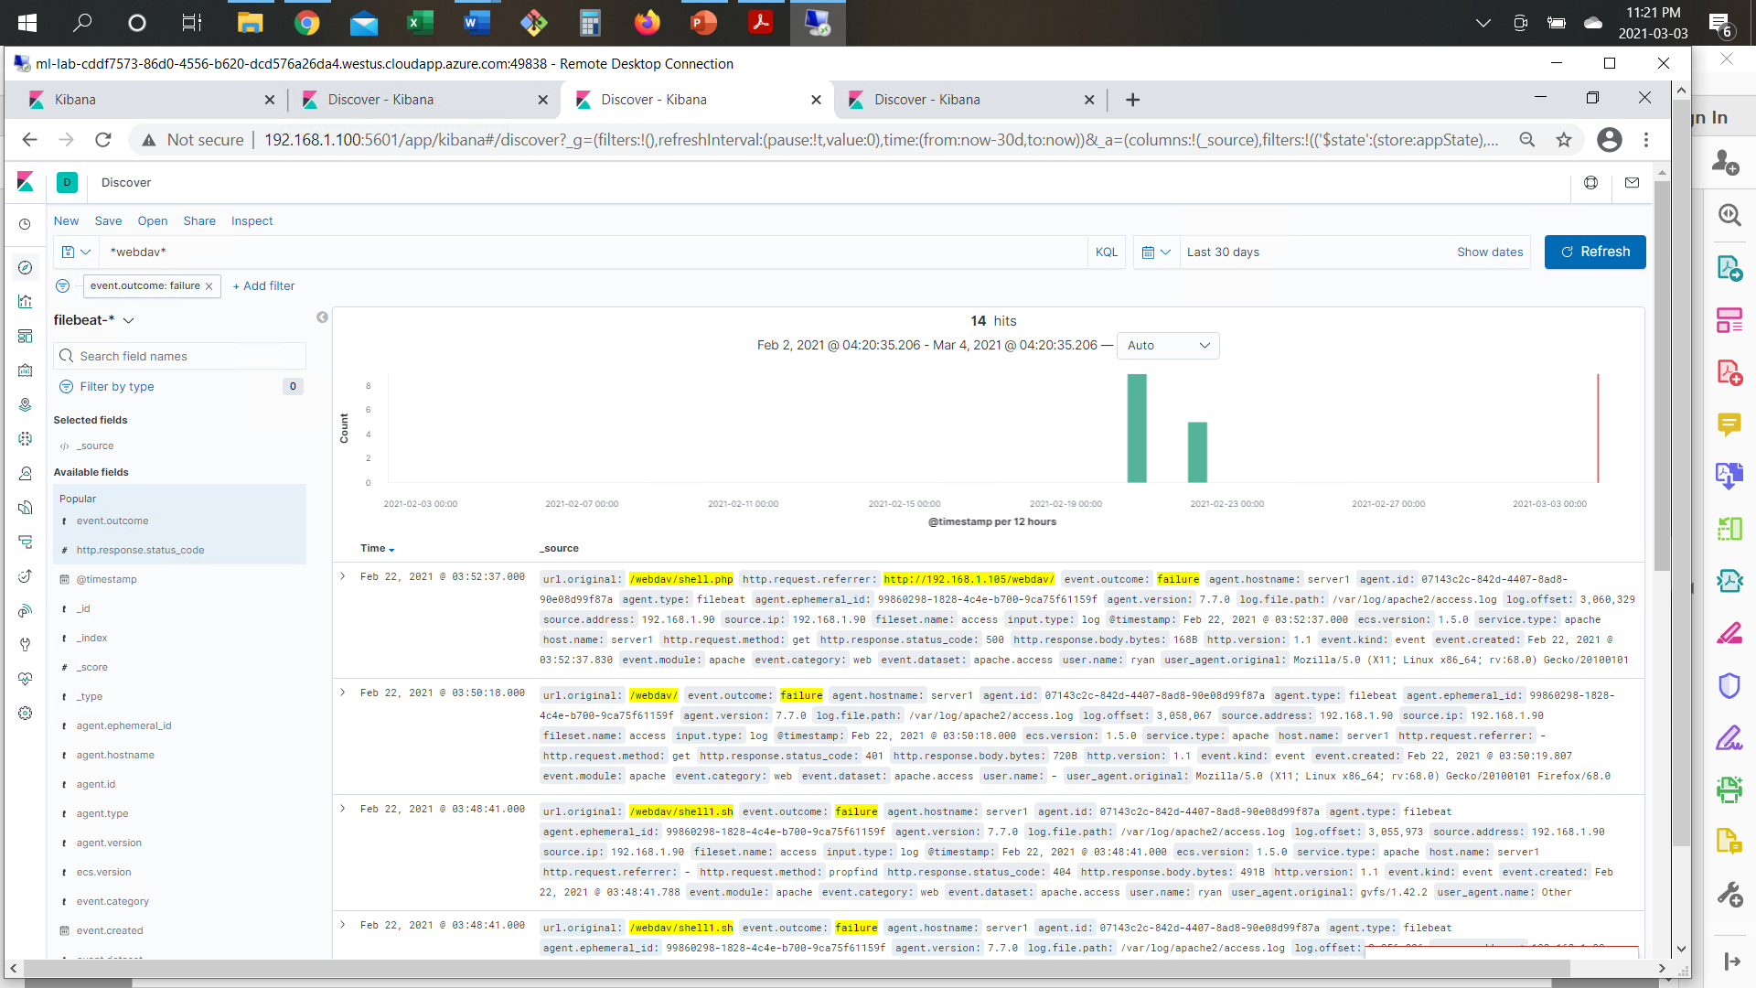
Analysis: Finding the WebDAV Connection
Answer the following questions in bullet points under the screenshot if space allows. Otherwise, add the answers to speaker notes.
14 requests were made to this directory?
File ‘shell.php’ has been uploaded
[Insert Here]
Add a screenshot of Kibana logs depicting the WebDAV connection.

Slide 17
Blue Team
Proposed Alarms and Mitigation Strategies
17

Slide 18
Mitigation: Blocking the Port Scan
What kind of alarm can be set to detect future port scans? - An alarm for multiple half-open connections from the same IP should be set.
What threshold would you set to activate this alarm? - Threshold for half-open connections from the same IP - 10 ports in a minute.
What configurations can be set on the host to mitigate port scans?- IP tables. Filtering ports on the web server.
Describe the solution. If possible, provide required command lines. - Block IPs
$IPT -A INPUT -p tcp –syn -m recent –name portscan –rcheck –seconds 60 –hitcount 10 -j LOG
$IPT -A INPUT -p tcp –syn -m recent –name portscan –set -j DROP

Slide 19
Mitigation: Finding the Request for the Hidden Directory
What kind of alarm can be set to detect future unauthorized access? - Set an alarm for each time ‘secret_time’ folder is registered in ELK logs.
What threshold would you set to activate this alarm? - Threshold - 1.
What configuration can be set on the host to block unwanted access? - Configuring WAF (Web Application Firewall) to restrict access to ‘secret_folder’.
Describe the solution. If possible, provide required command lines. - WAF will allow only authorized IPs to access
secret_folder.

Slide 20
Mitigation: Preventing Brute Force Attacks
What kind of alarm can be set to detect future brute force attacks? - An alarm for multiple unauthorized access attempts ERROR 401 to be set.
What threshold would you set to activate this alarm? - Threshold of 5 failed attempts within a minute/from the same IP.
What configuration can be set on the host to block brute force attacks? - Introduce muti-factor authentication, complex username and password policies, account lockout.
Describe the solution. If possible, provide the required command line(s). - Introduce muti-factor authentication, complex username and password policies, account lockout after six failed attempts.

Slide 21
Mitigation: Detecting the WebDAV Connection
What kind of alarm can be set to detect future access to this directory? - Set an alarm for each time ‘secret_time’ folder appears in ELK logs.
What threshold would you set to activate this alarm? - Threshold - 1.
What configuration can be set on the host to control access?- Install updates, Remove SMB, Remove guest authentication and fallback, Disable the WebDAV protocol, Restrict outbound SMB destinations by firewall, Use UNC Hardening to require signing, encryption, and mutual authentication, Use SMB 3.1.1, Map drives on the fly with mandated signing or encryption, Block NTLM & increase Kerberos Security, harden WEBDAV
Describe the solution. If possible, provide the required command line(s).

Slide 22
Mitigation: Identifying Reverse Shell Uploads
What kind of alarm can be set to detect future file uploads? - Alarm for reverse shell signatures.
What threshold would you set to activate this alarm? - Threshold - 1.
What configuration can be set on the host to block file uploads? - IPS rule to detect and prevent malicious reverse shell upload. Remove write permissions for www-data
Describe the solution. If possible, provide the required command line. – IPS to monitor signatures for reverse shell connection and block source IP

